Slide 1

(Developing advanced Engine Multi-disciplinary Optimisation Simulations)
DEMOS Final Meeting
Overview of Project Structure & Objectives
17th December 2019
Empresarios Agrupados Internacional (EAI)
Cranfield University (CU)
National Technical University of Athens (NTUA)

Slide 2
Project Objectives

Slide 3
DEMOS main achievements
1
    Development of advanced simulation techniques to improve the monitoring of communication between integrated models, robustness and convergence (WP2)
2
    Develop a suite of advanced solvers to enable extended transient capabilities and simulation of complex aeronautical systems (including control) (WP2)
3
    Enable complex propulsion system performance optimization with constraint handling capability (WP3)
4
    Adapt and develop a set of reliable and robust models to simulate/optimise performance of advanced propulsion system architectures (WP3)
5
    Assess the effect and influence of novel components on the propulsion system performance in terms of overall performance (WP3-4-5-6-7)
6
    Develop a modular approach to enable integration and further development of main modules for preliminary design process (WP3-4-5-6-7)

Slide 4
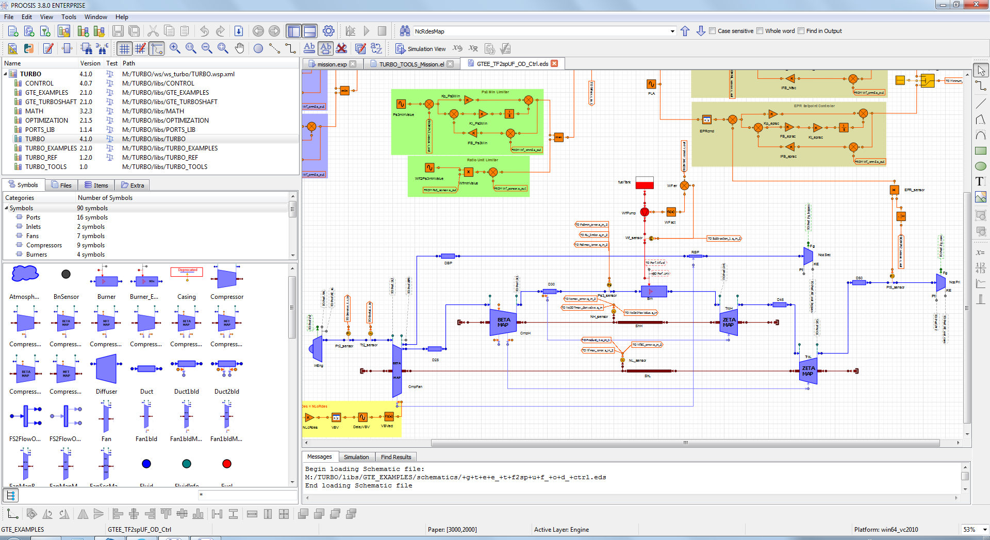
WP-2 Process development
Please report relevant Pictures (if any) showing main achievements
Please report relevant Pictures (if any) showing main achievements
Figure - xxxxxxxx
Figure - xxxxxxxx
PROOSIS 6.0 Modelling & Simulation tool. Engine model with control system
Project DEMOS– GA n. 686340

Slide 5
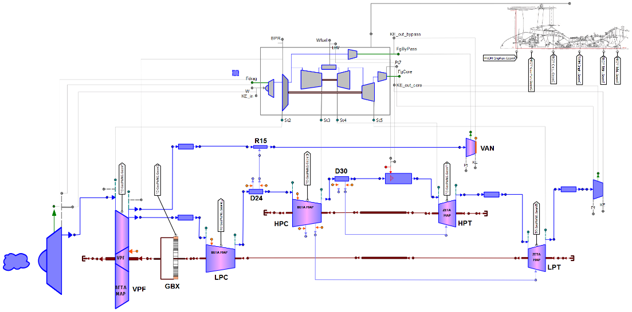
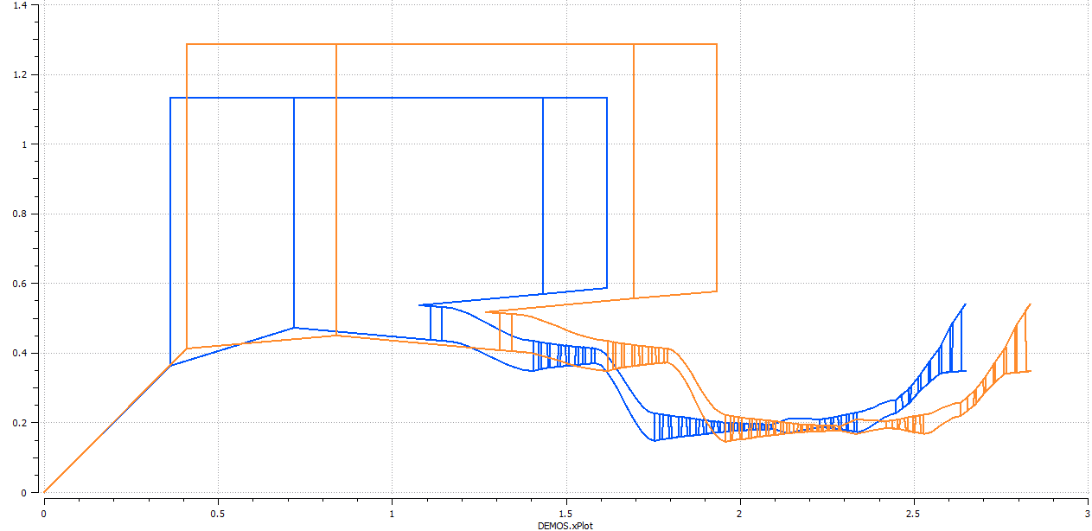
Staus of Project – Main Achievements
WP-3 Modelling
  Example:
  UBGF
  model in
  PROOSIS
Figure 3 – UBGF PROOSIS Schematic Model
Calculated UBGF Gas Path Geometry
for different Fan Pressure Ratio Values
Parametric study results
Project DEMOS– GA n. 686340

Slide 6
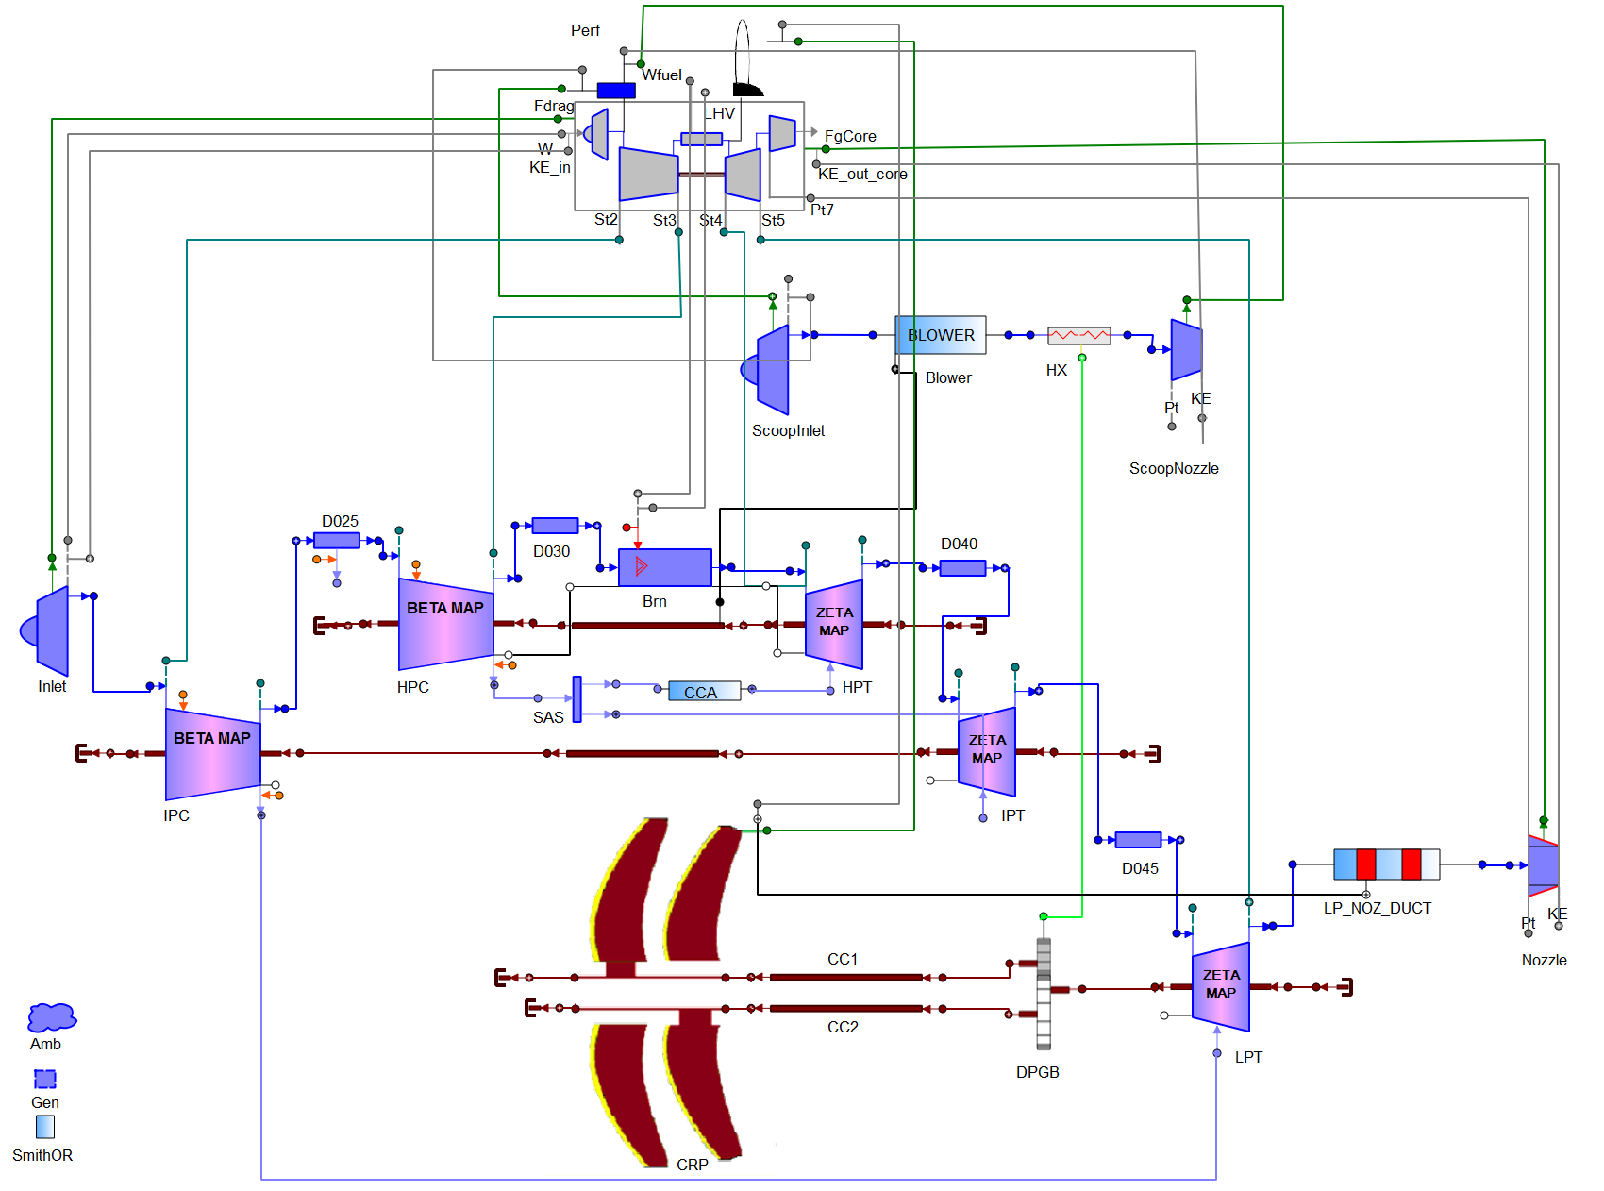
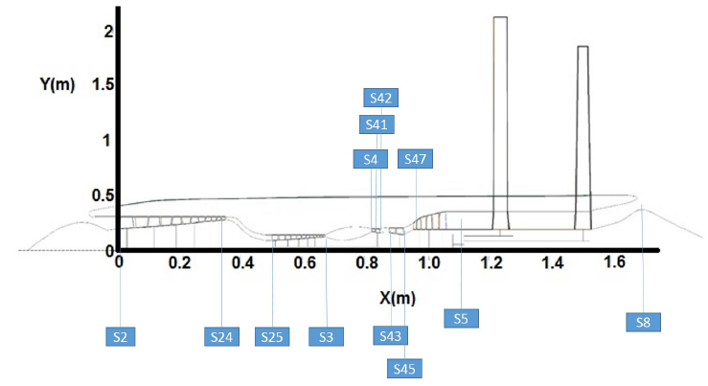
WP-3 Modelling
  Example:
  GOR model in PROOSIS
GOR Schematic in PROOSIS
Calculated GOR Gas Path Geometry

Slide 7
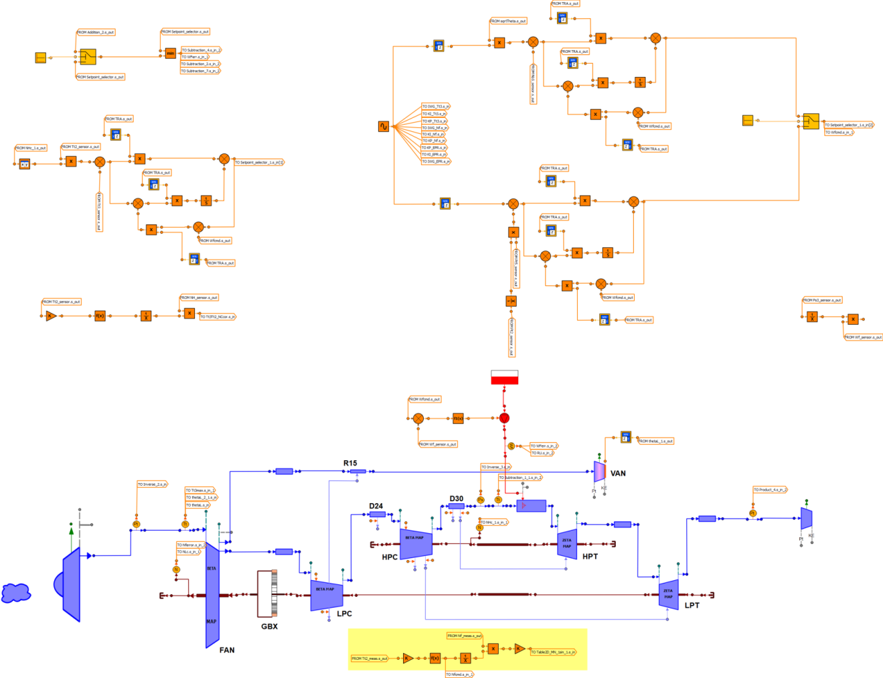
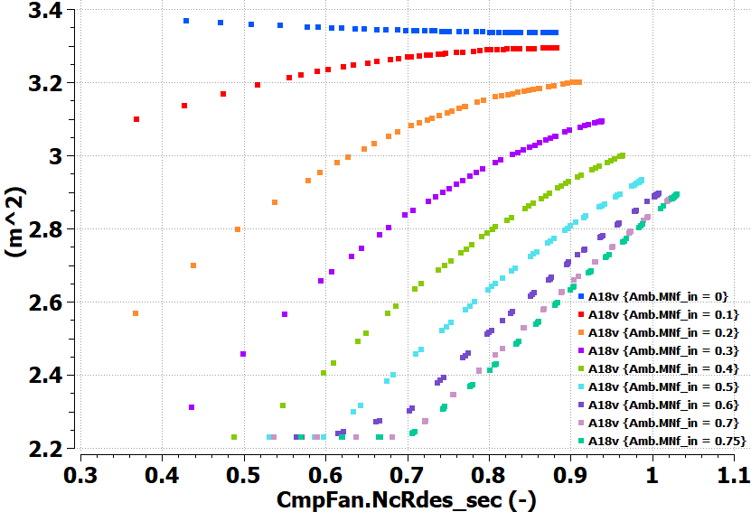
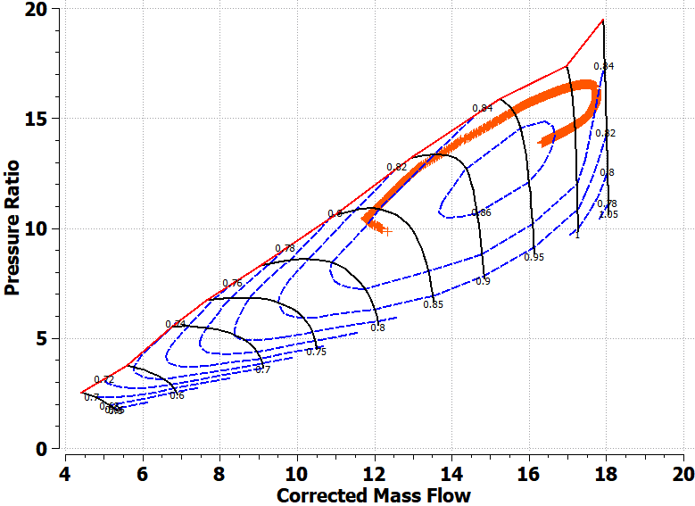
WP-4 Control & Transient
UBGF VAN Control Schedule
UBGF Engine Model Connected to the Controller
Operating line on HP Compressor for a Sudden Acceleration at SLS from 10% to 95% of max thrust in 4s

Slide 8
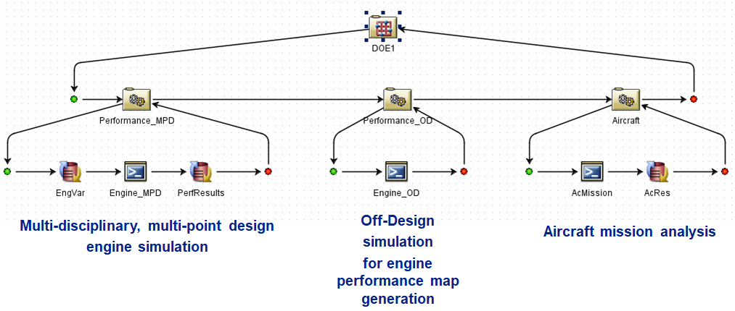
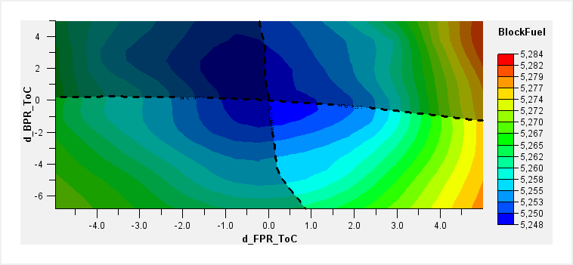
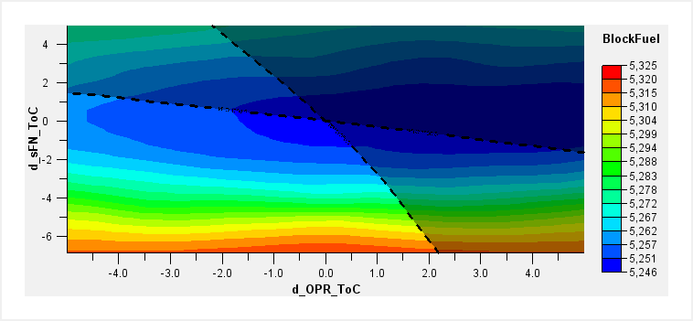
WP-5 MDO
Simulation Flow in iSight for UBGF Optimization studies at Aircraft Mission Level
DoE studies around UBGF optimum location

Slide 9
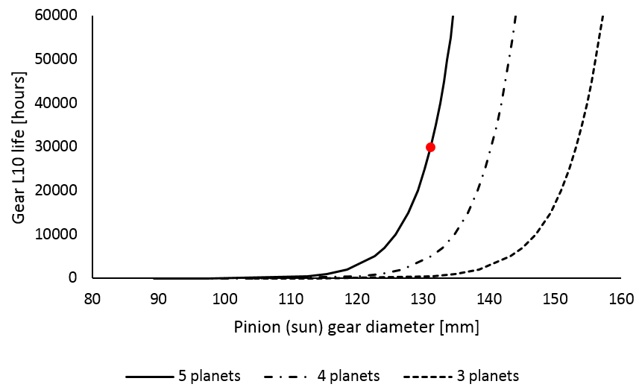
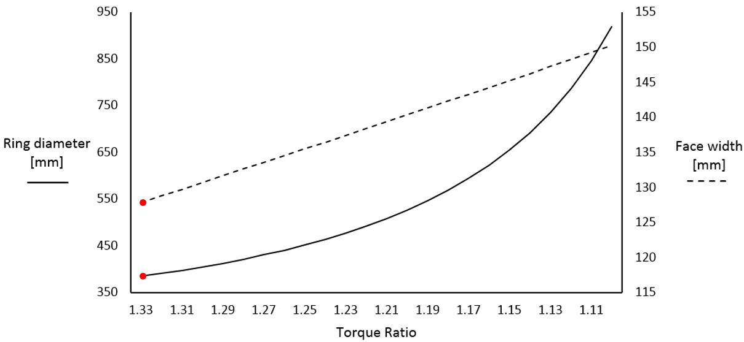
WP-6 Process development
  Sensitivity analysis of the GOR gearbox design performed within a TERA2025 framework
Evolution pinion (sun) gear diameter with design life requirement
Torque ratio impact on the ring diameter and the face width of the gears

